Slide 1
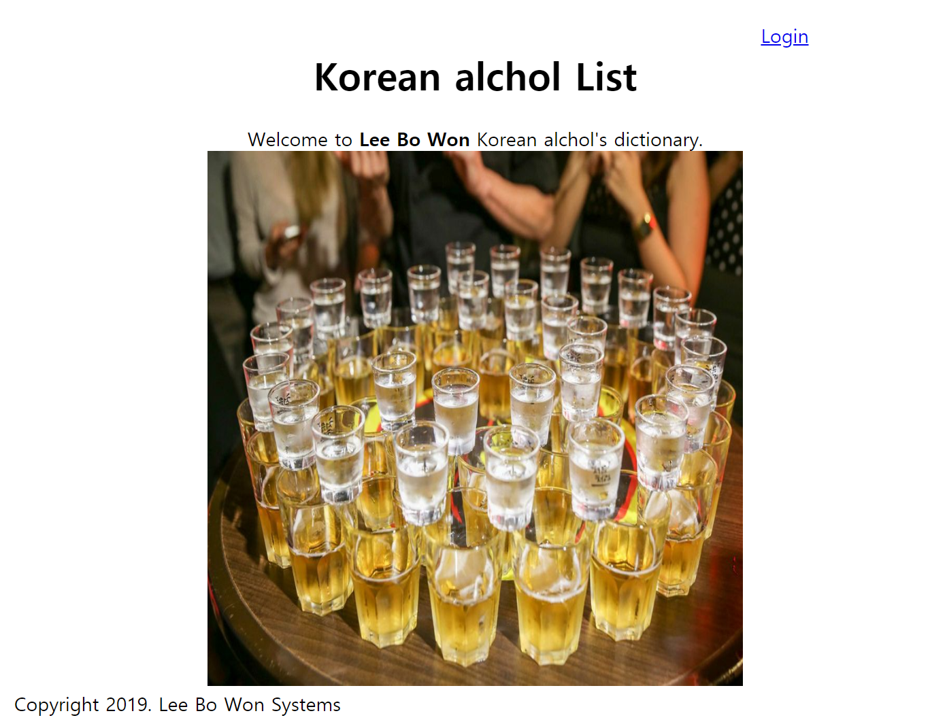
Web Programming Spring 2019
Final Project
Mechanical engineering
Lee Bo Won

Slide 2
Index
Create Login session using php
Divide access authority between the admin and the clerk
In admin = you can add the list of Korean alchol
In clerk = you can watch what it is in it
The data is stored in phpmyadmin

Slide 3
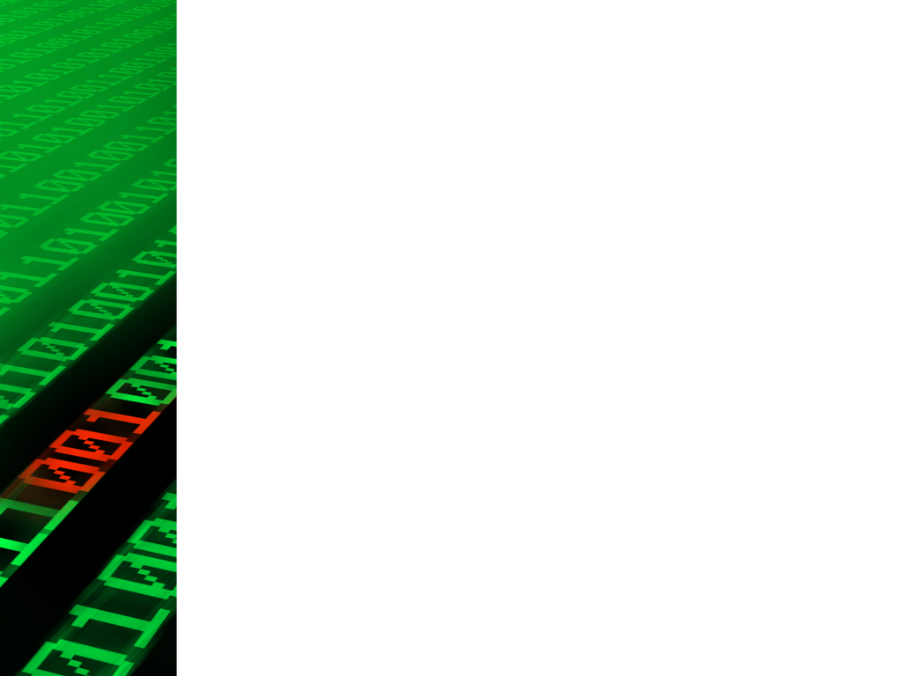
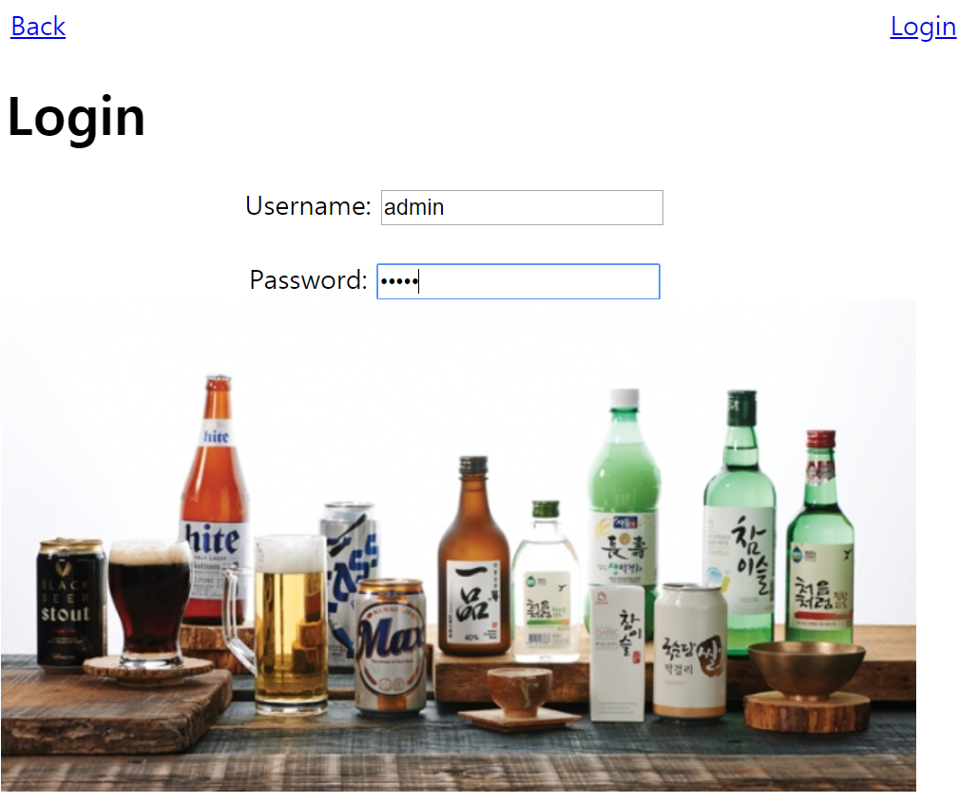
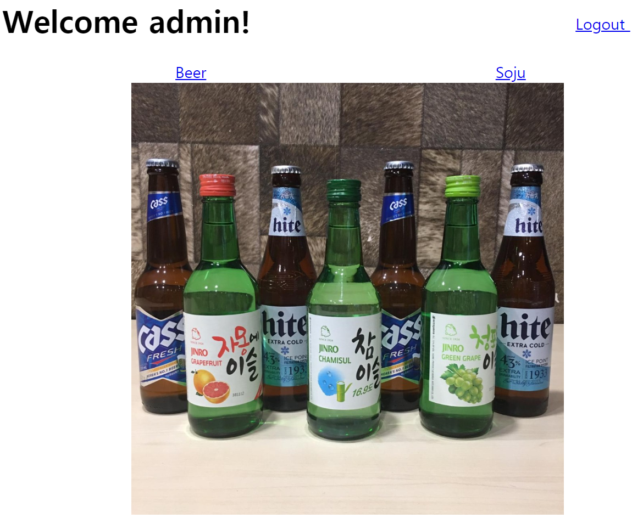
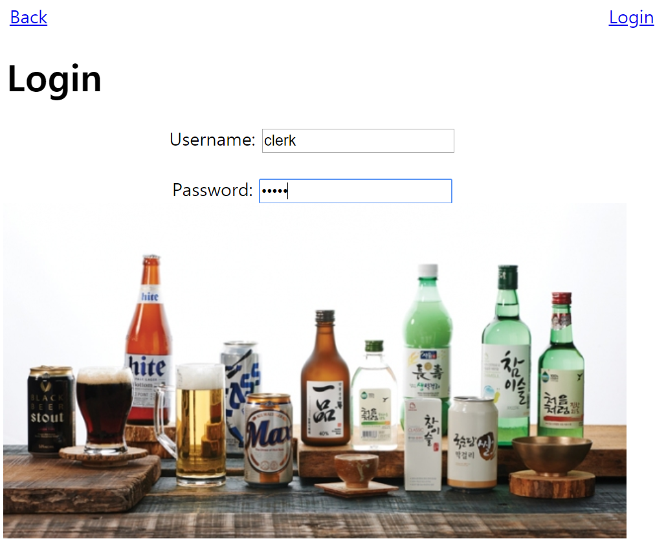
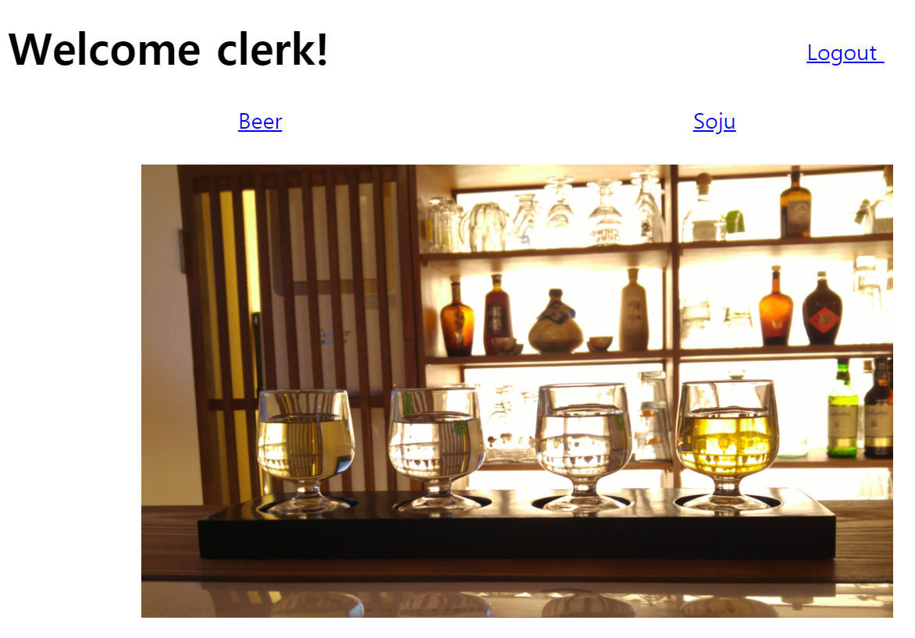
Create Login session using php
When you login as admin
When you login as clerk

Slide 4
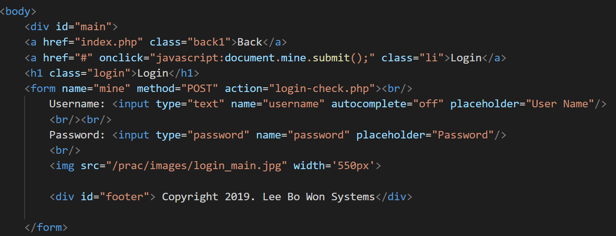
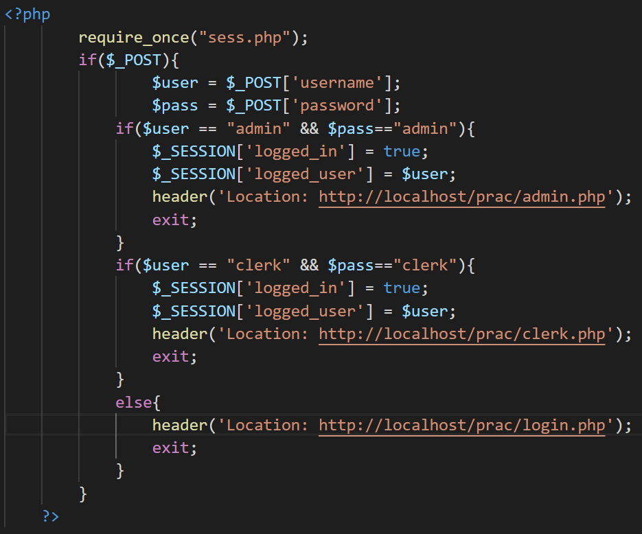
Create Login session using php
Login.php
Login-check.php

Slide 5
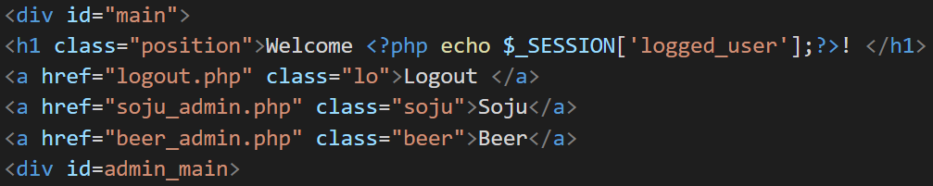
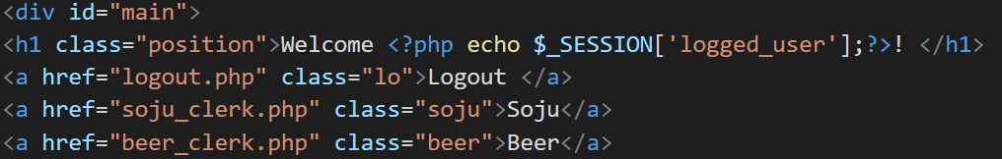
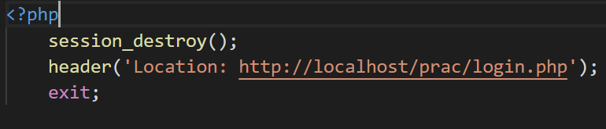
Divide access authority between the admin and the clerk
admin.php
clerk.php
Logout.php

Slide 6
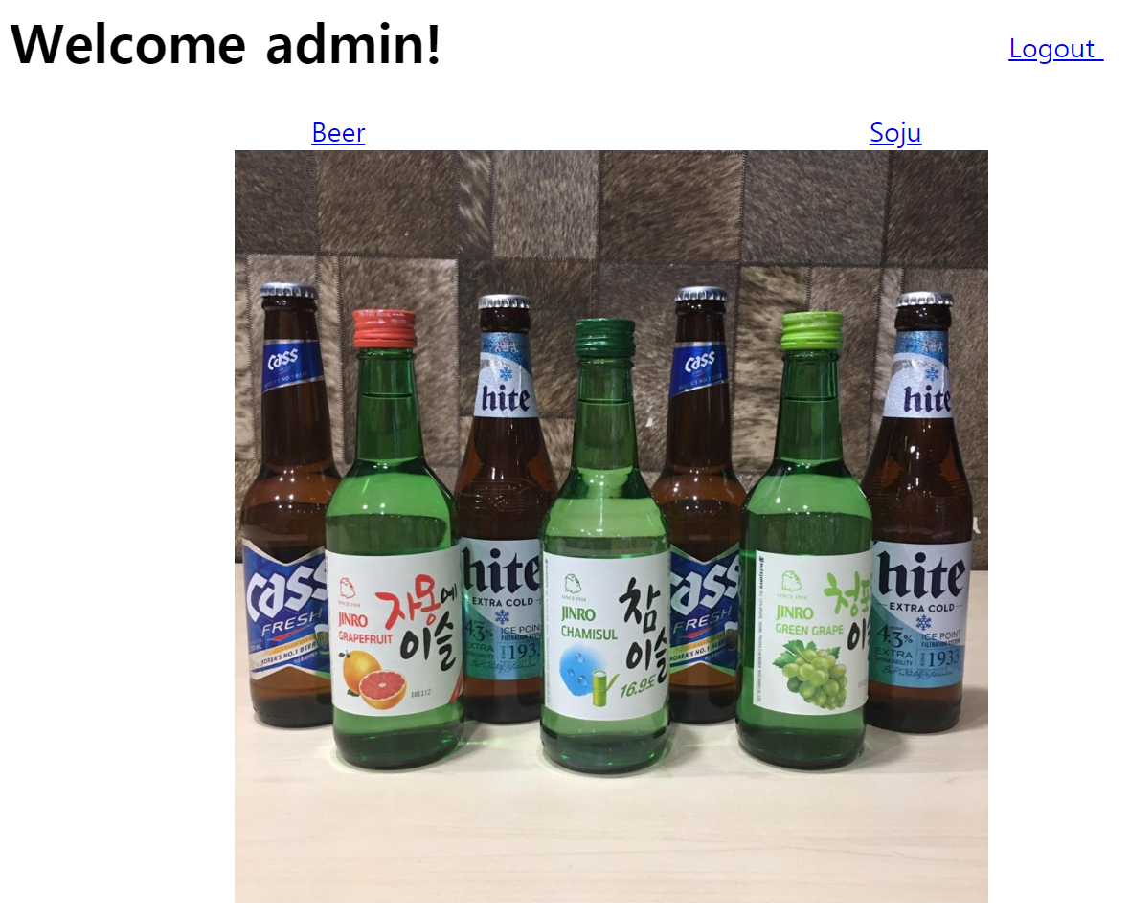
In admin , you can add the list of Korean alchol
admin.php

Slide 7
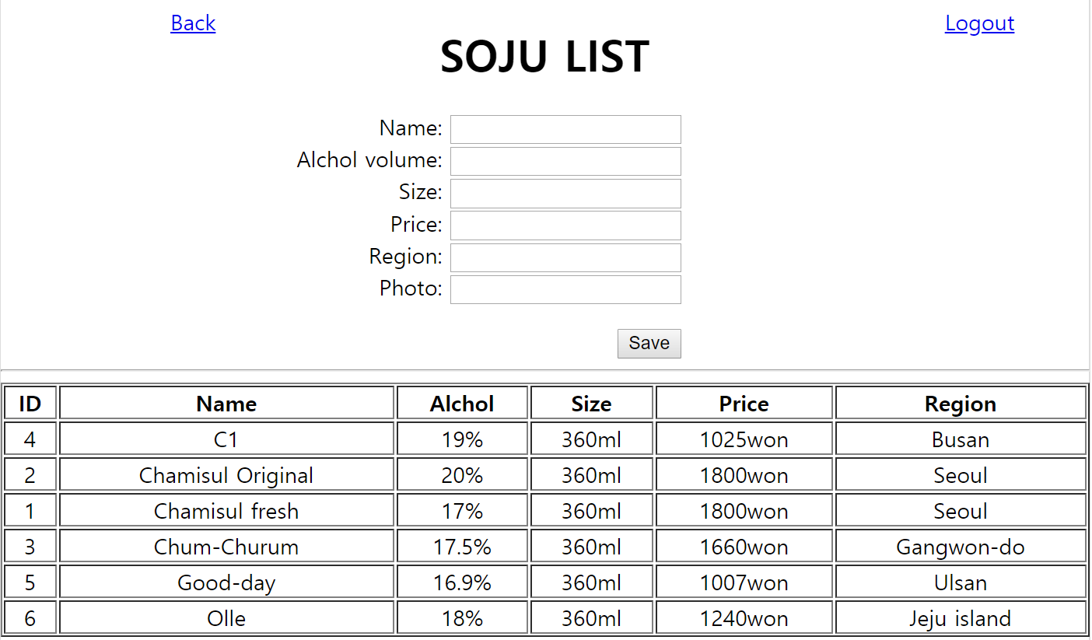
In admin , you can add the list of Korean alchol
soju_admin.php

Slide 8
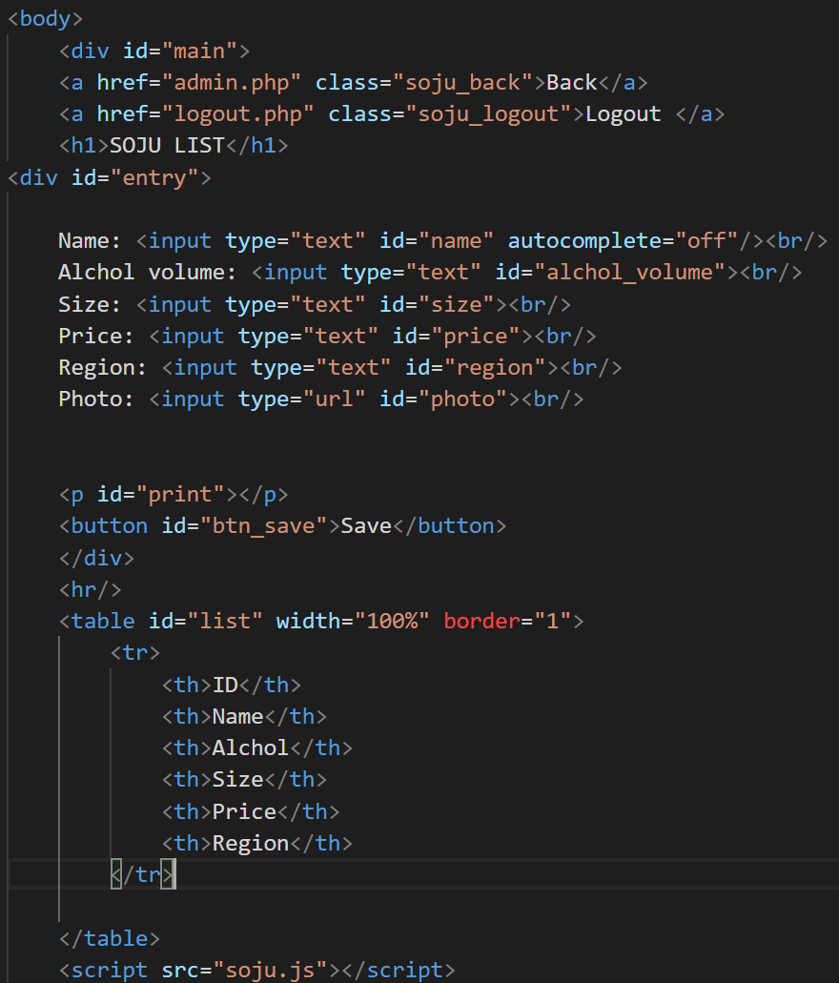
In admin , you can add the list of Korean alchol
soju_admin.php

Slide 9
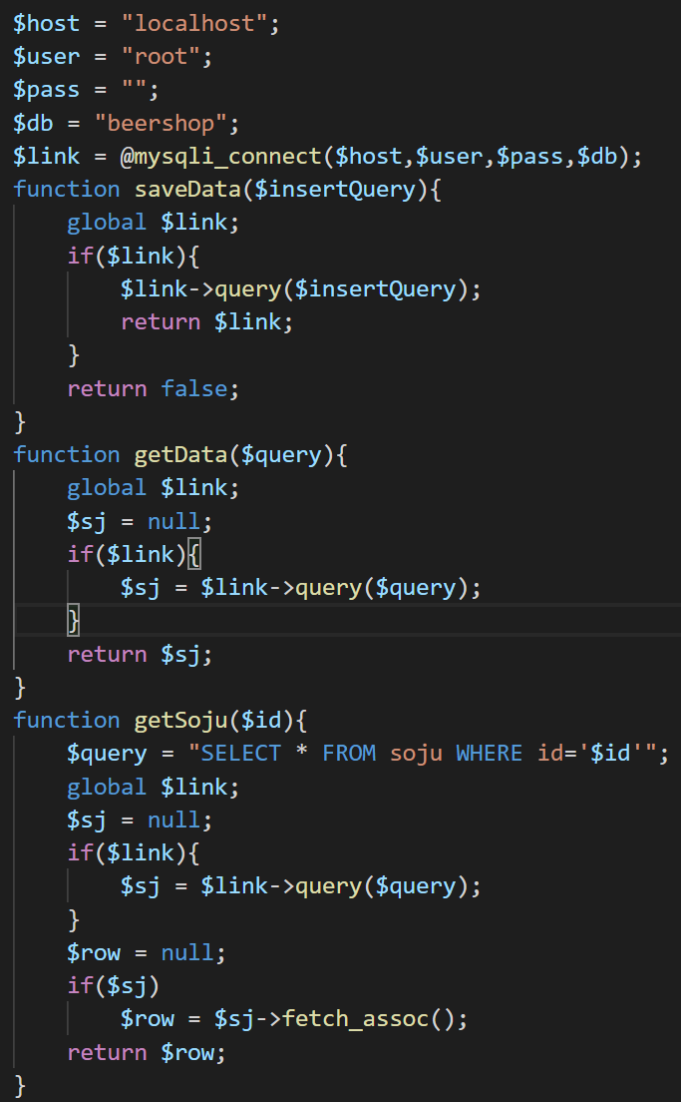
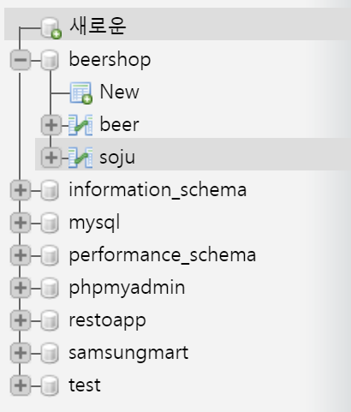
Set the api
soju_db_functions.php
Localhost/phpmyadmin

Slide 10
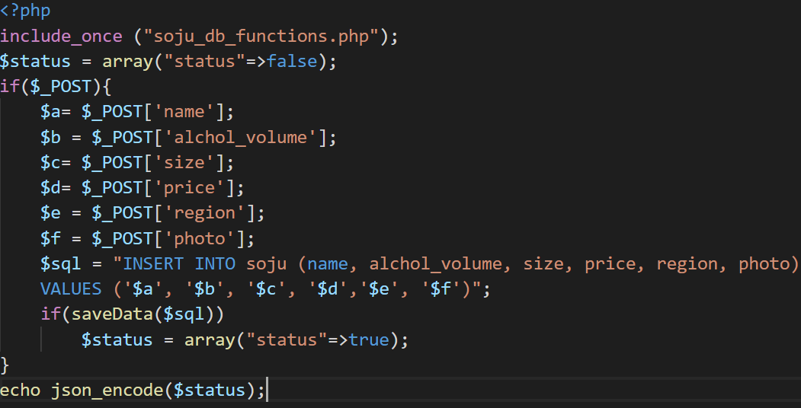
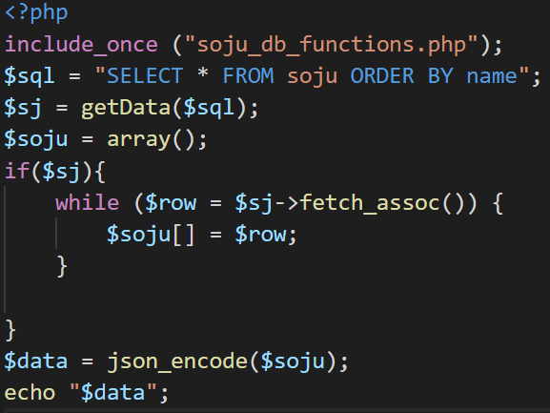
Set the api
soju_save.php
soju.php

Slide 11
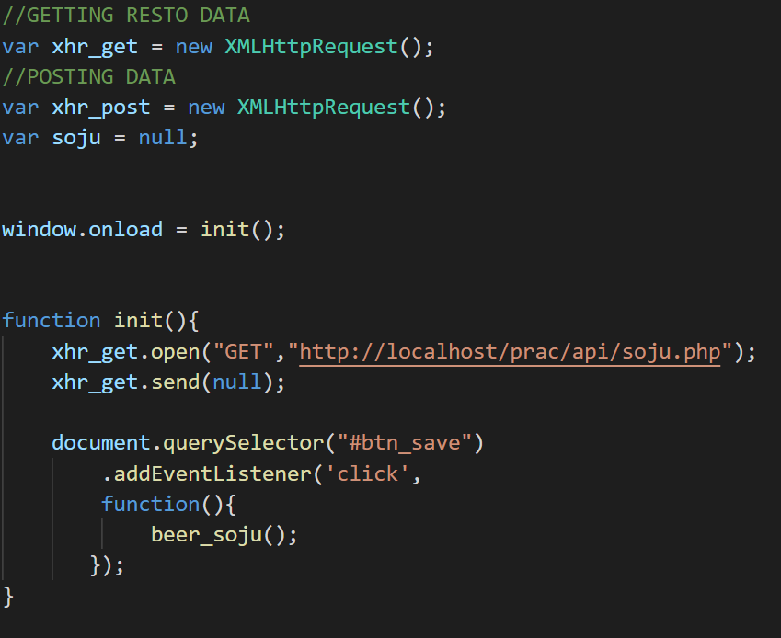
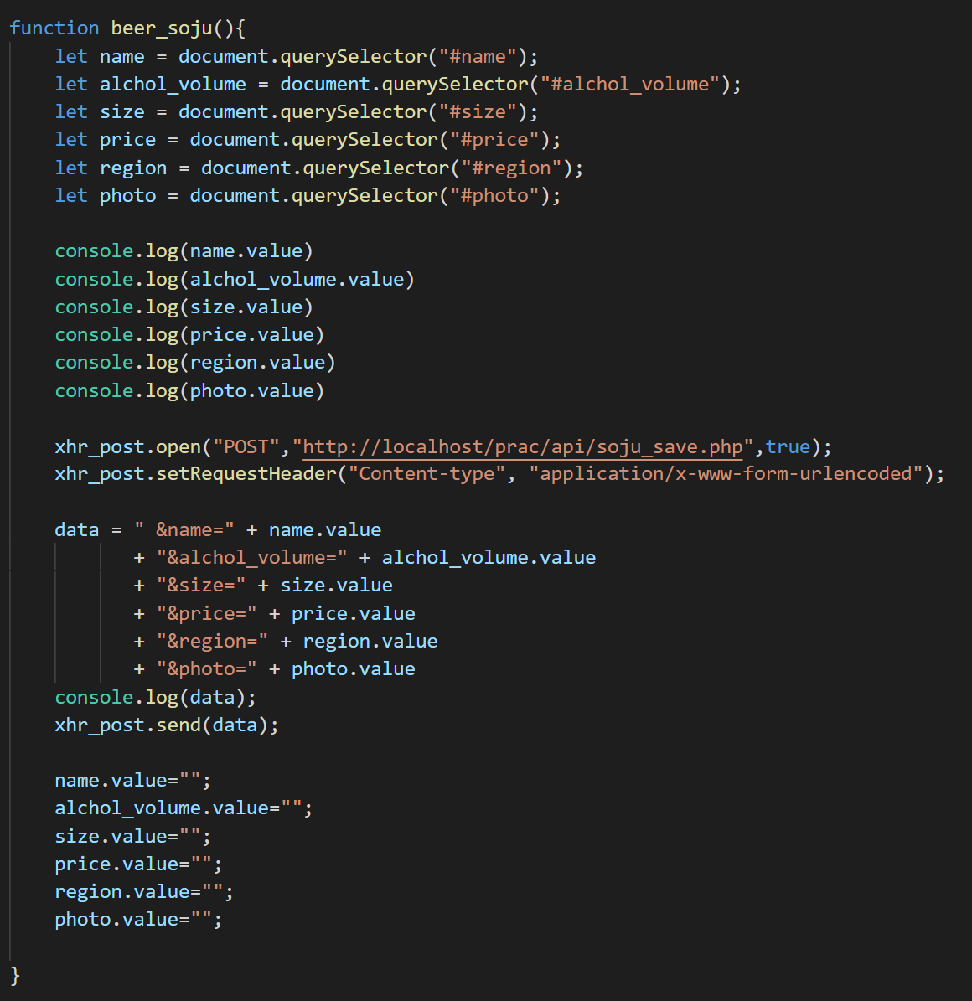
In admin , you can add the list of Korean alchol
soju.js

Slide 12
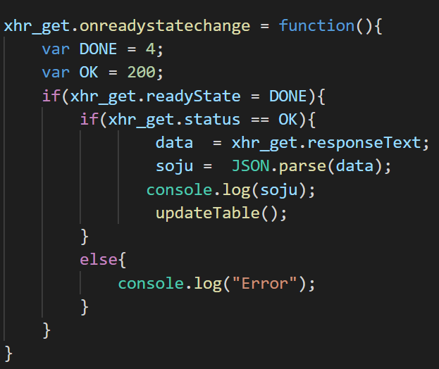
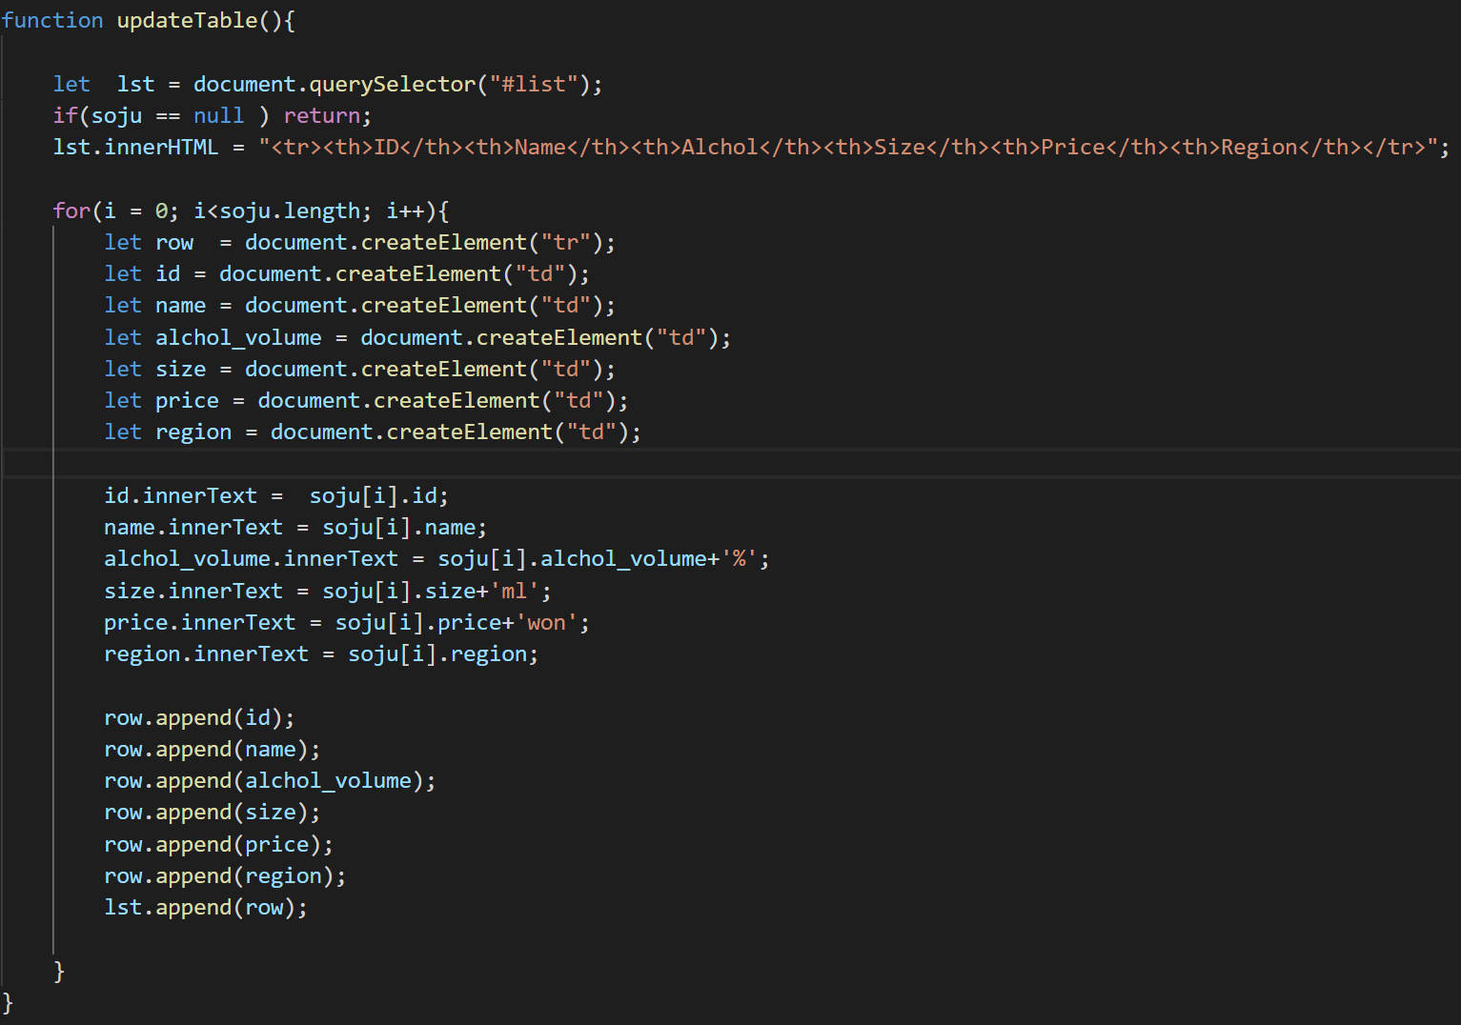
In admin , you can add the list of Korean alchol
soju.js

Slide 13
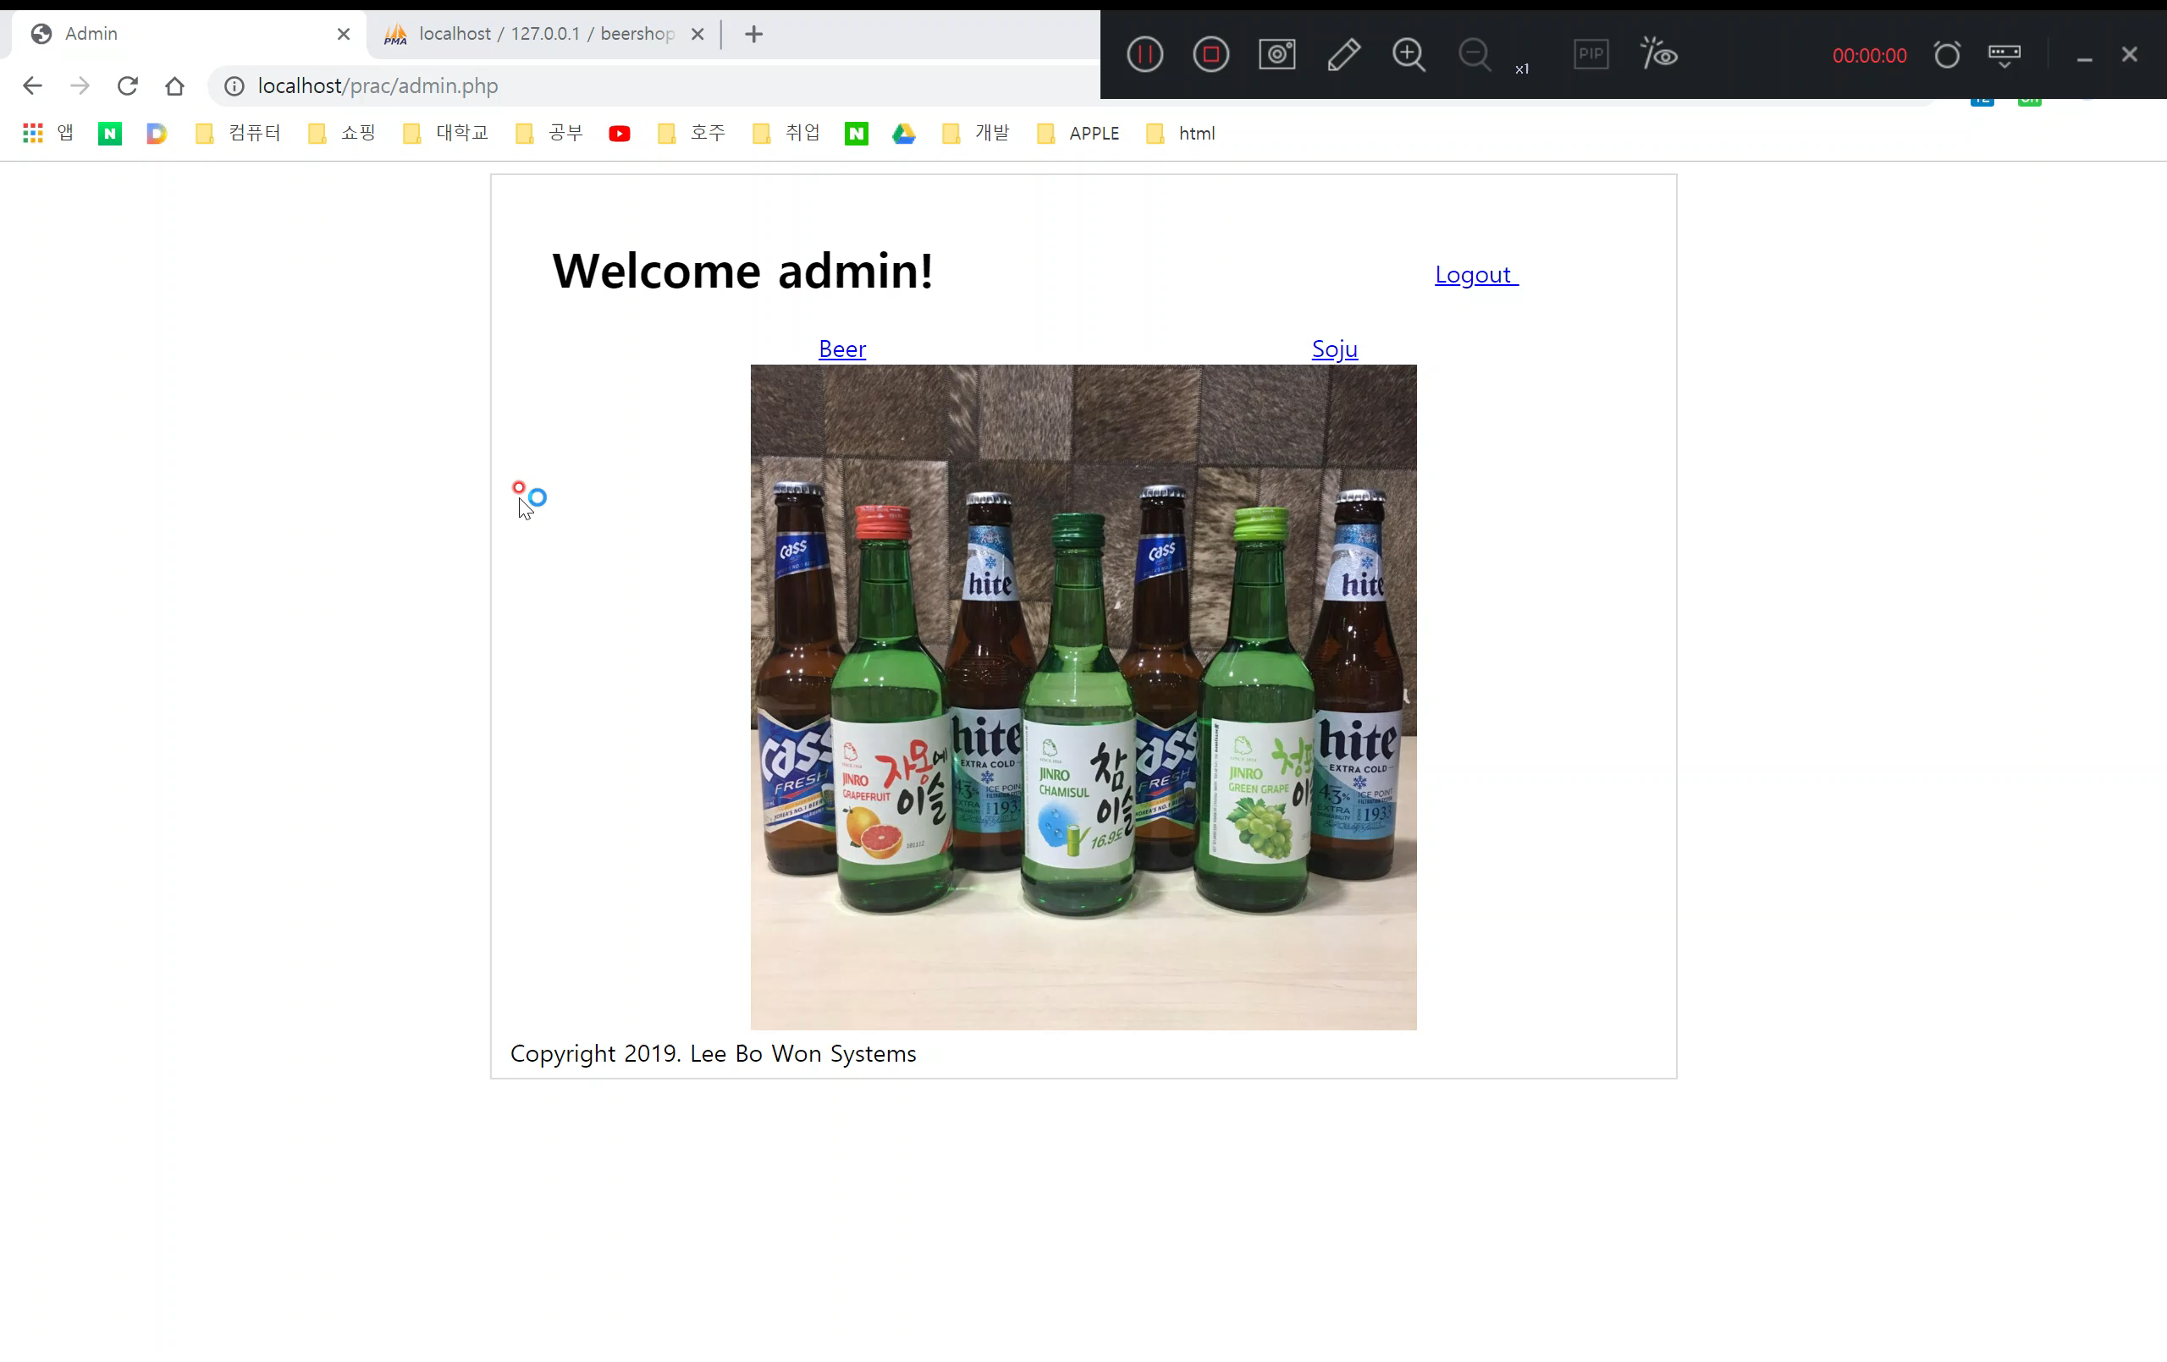
In admin , you can add the list of Korean alchol

Slide 14
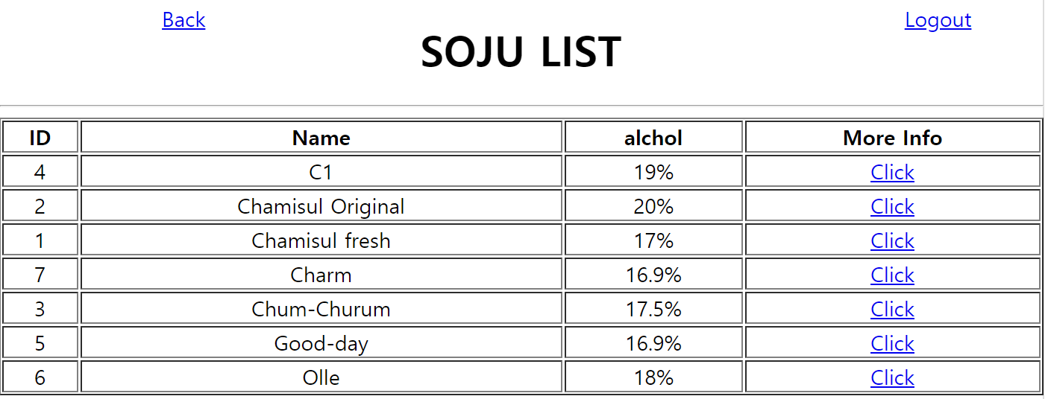
In clerk = you can watch what it is in it

Slide 15
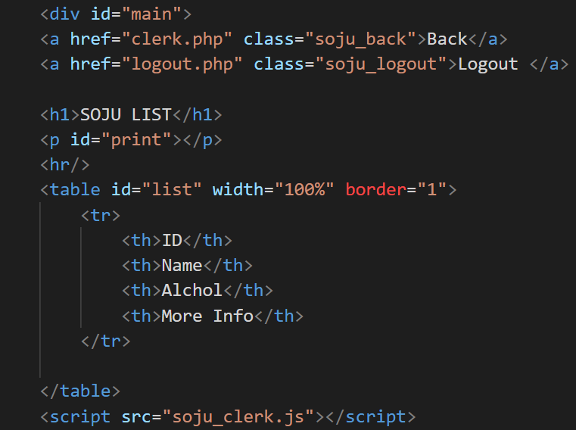
In clerk = you can watch what it is in it
soju_clerk.php

Slide 16
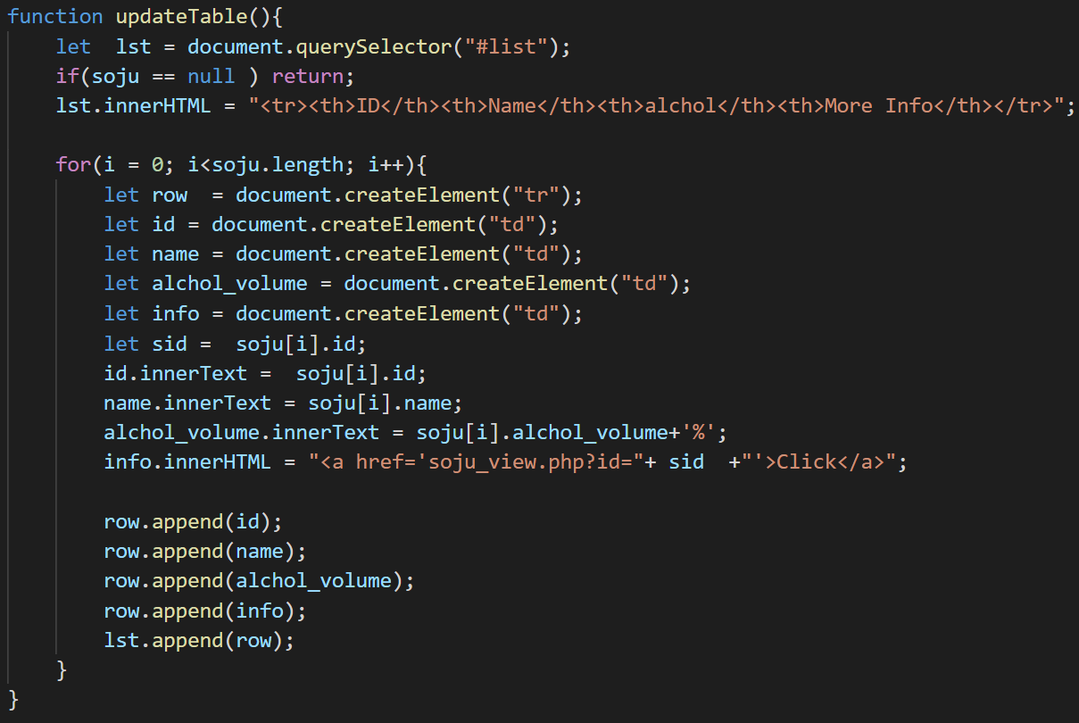
In clerk = you can watch what it is in it
soju_clerk.js
It’s all the same compare with soju.js except function updateTable

Slide 17
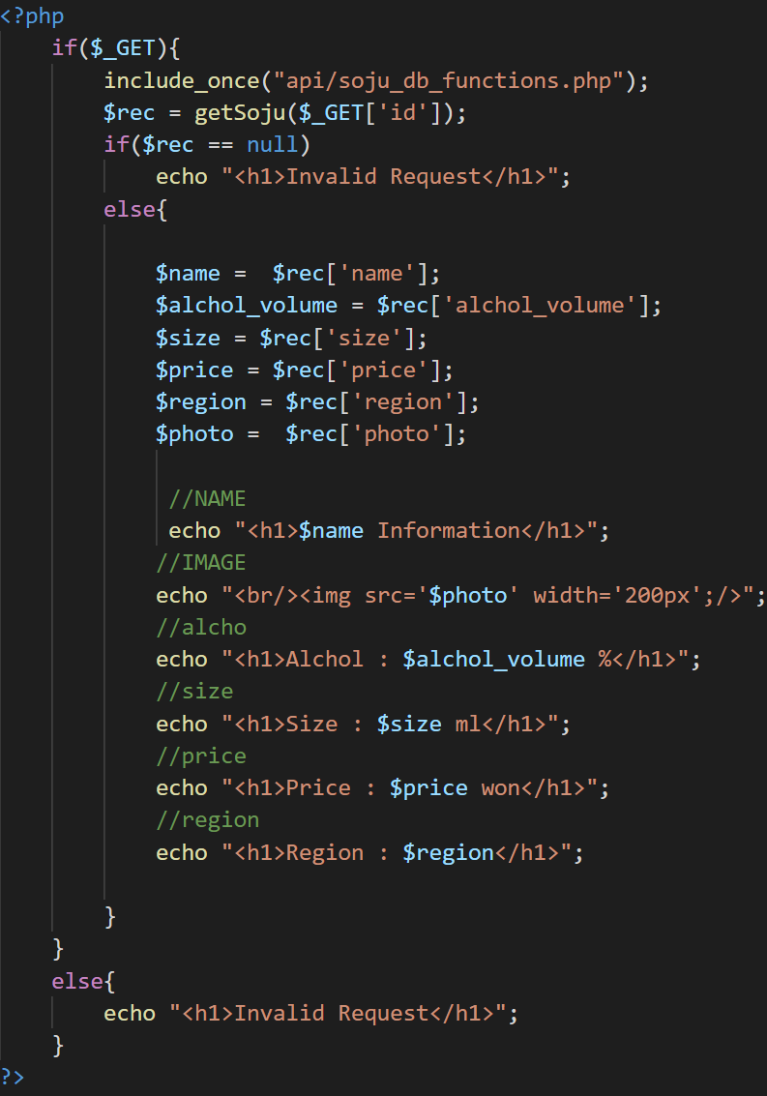
In clerk = you can watch what it is in it
soju_view.php

Slide 18
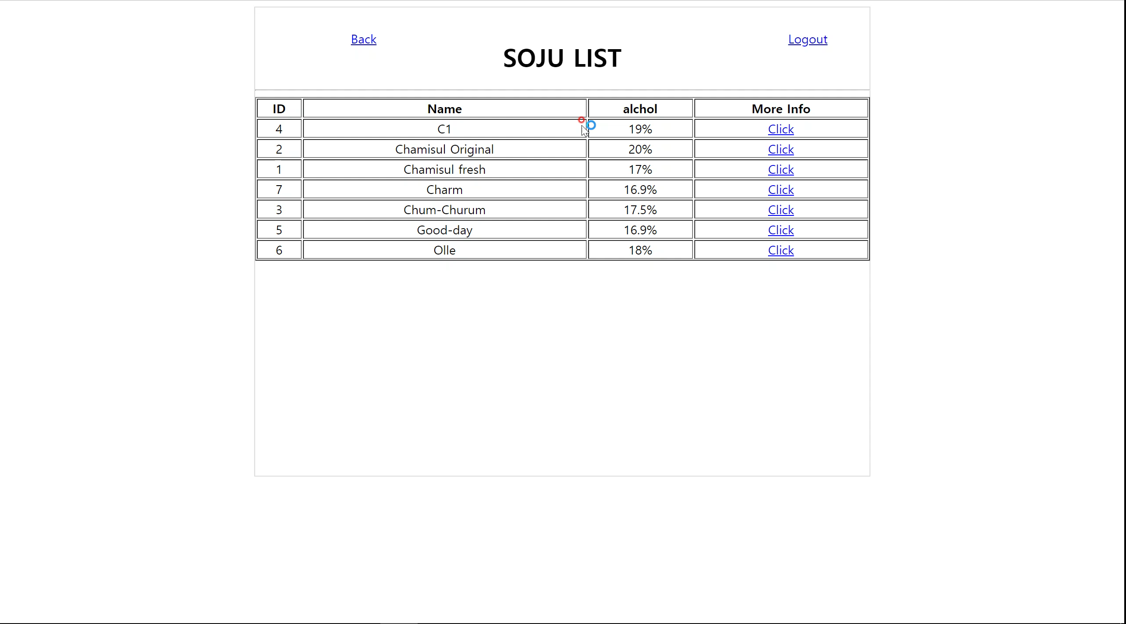
In clerk = you can watch what it is in it

Slide 19
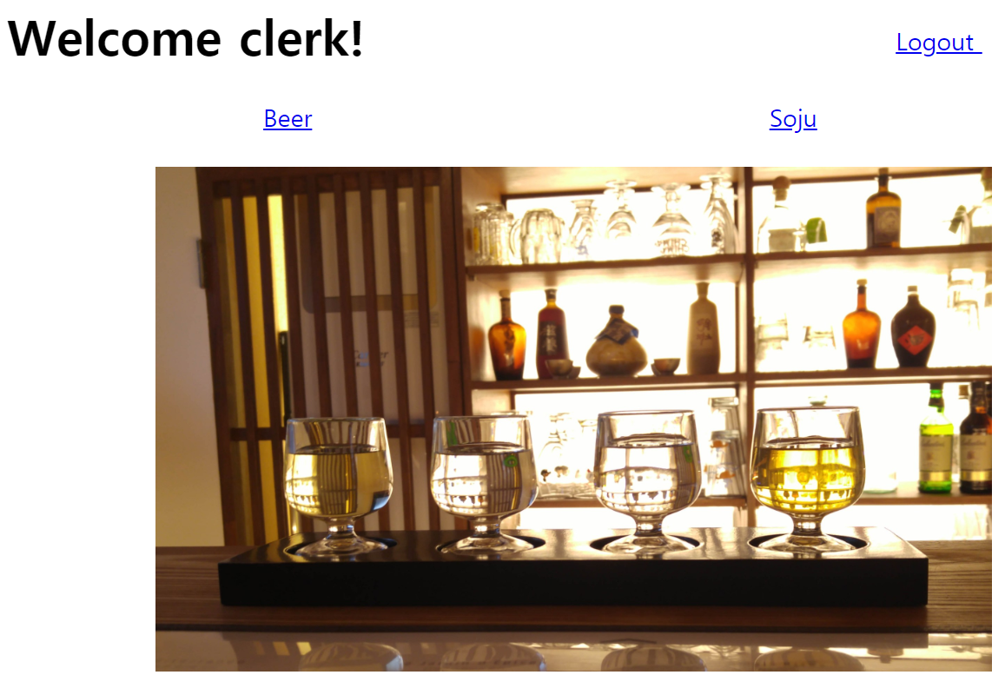
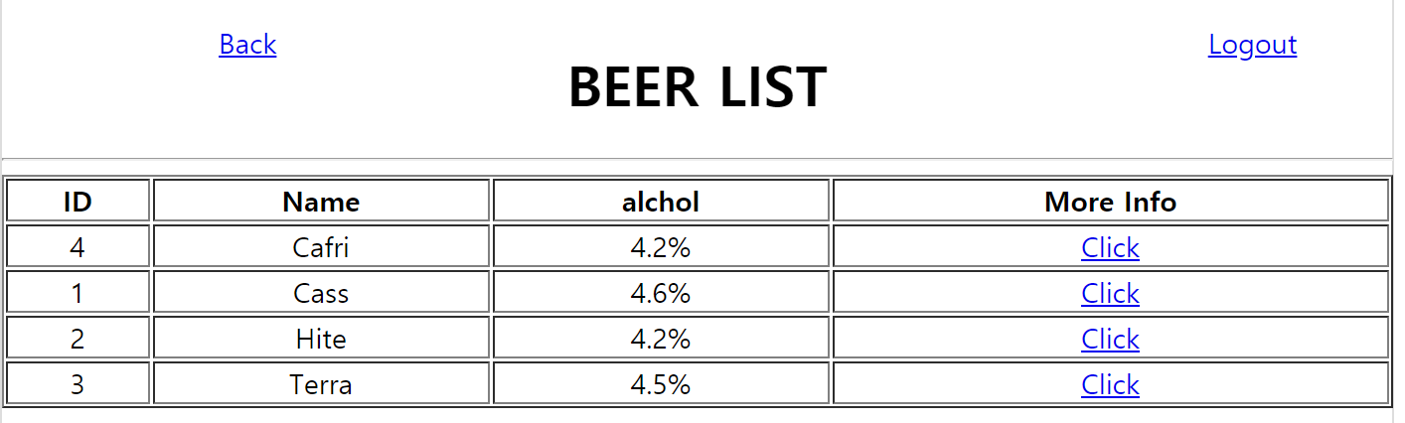
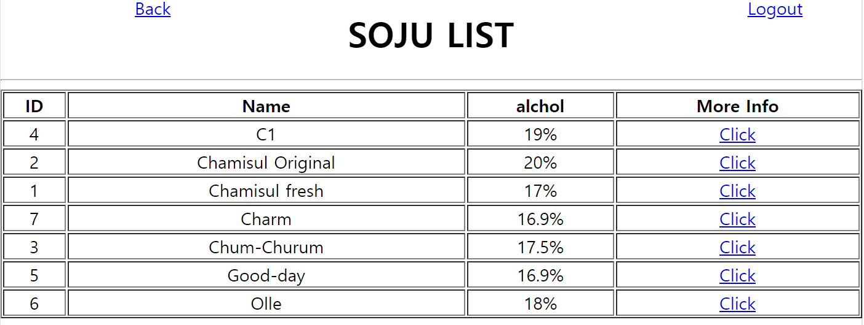
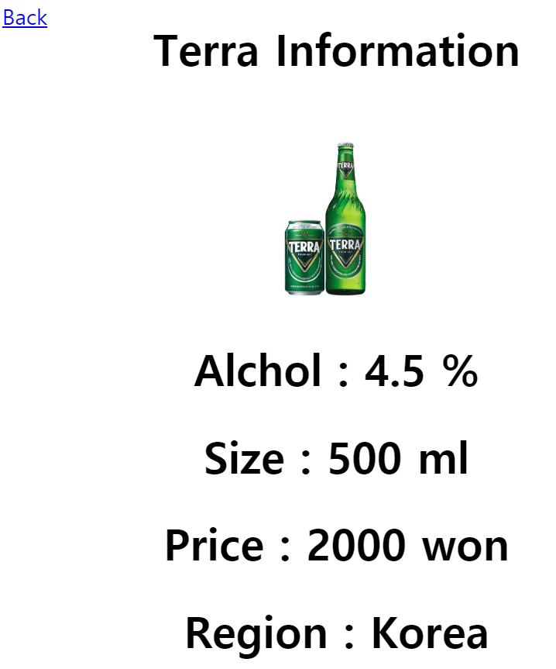
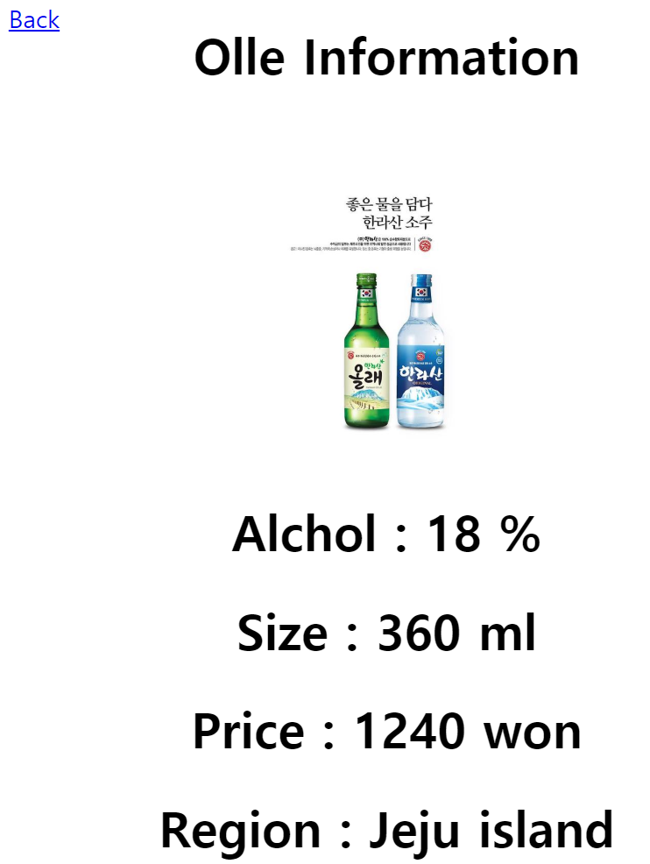
Login as clerk

Slide 20
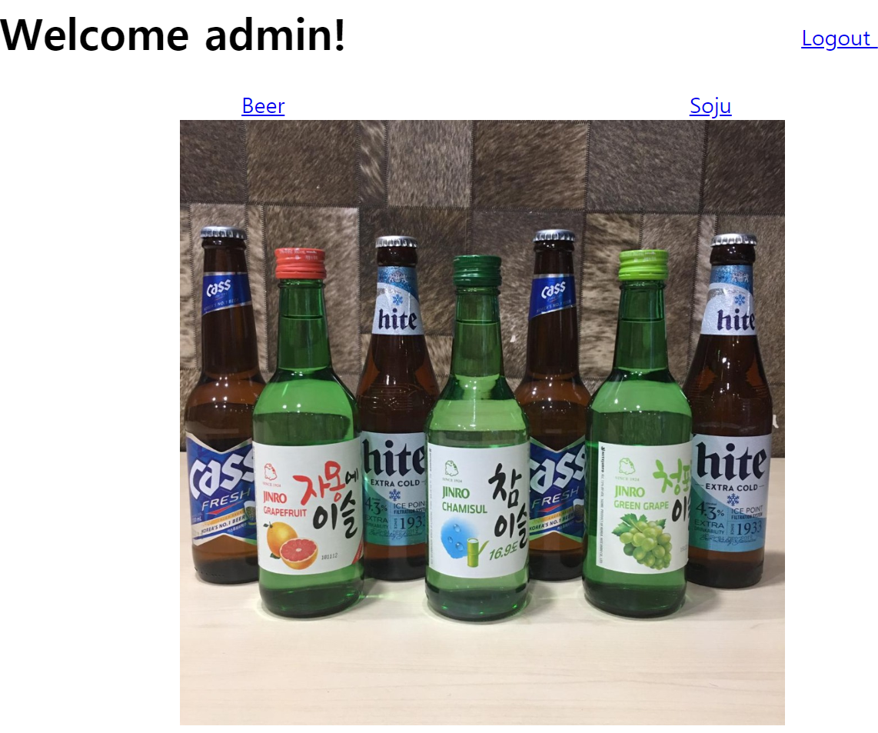
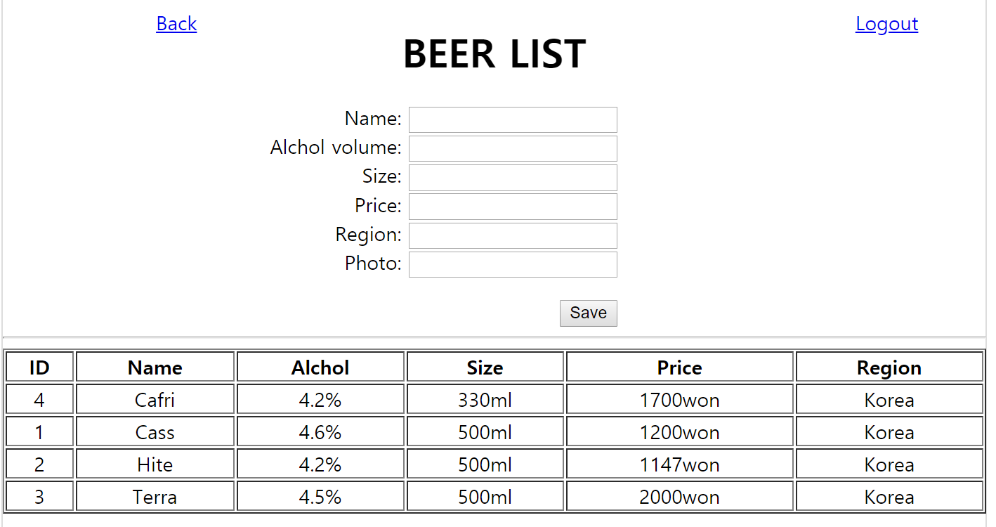
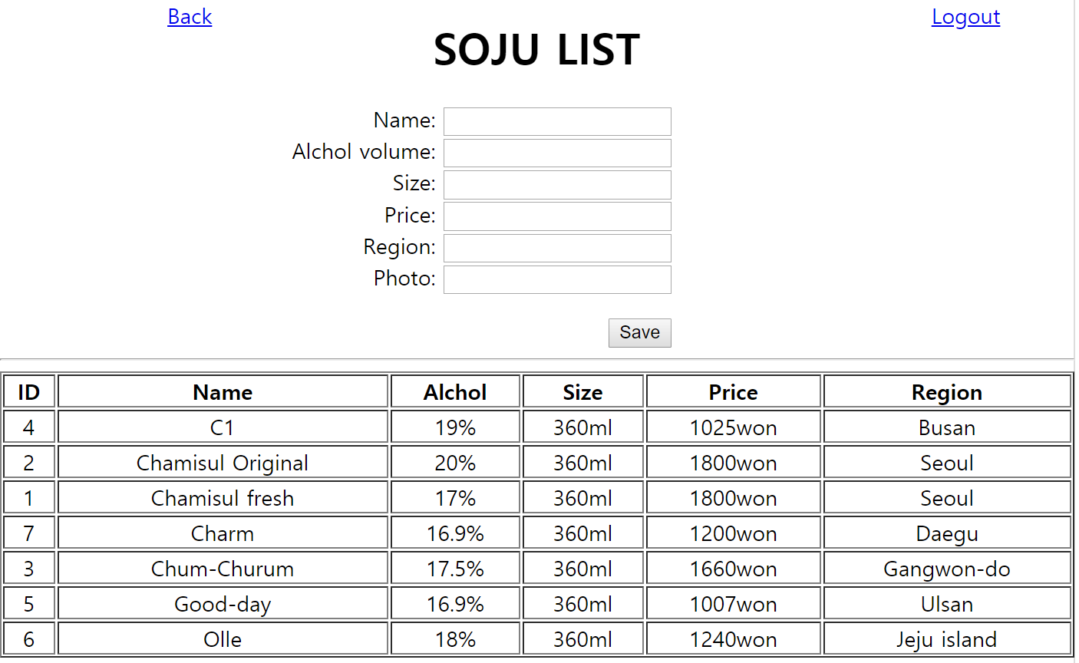
Login as admin

Slide 21
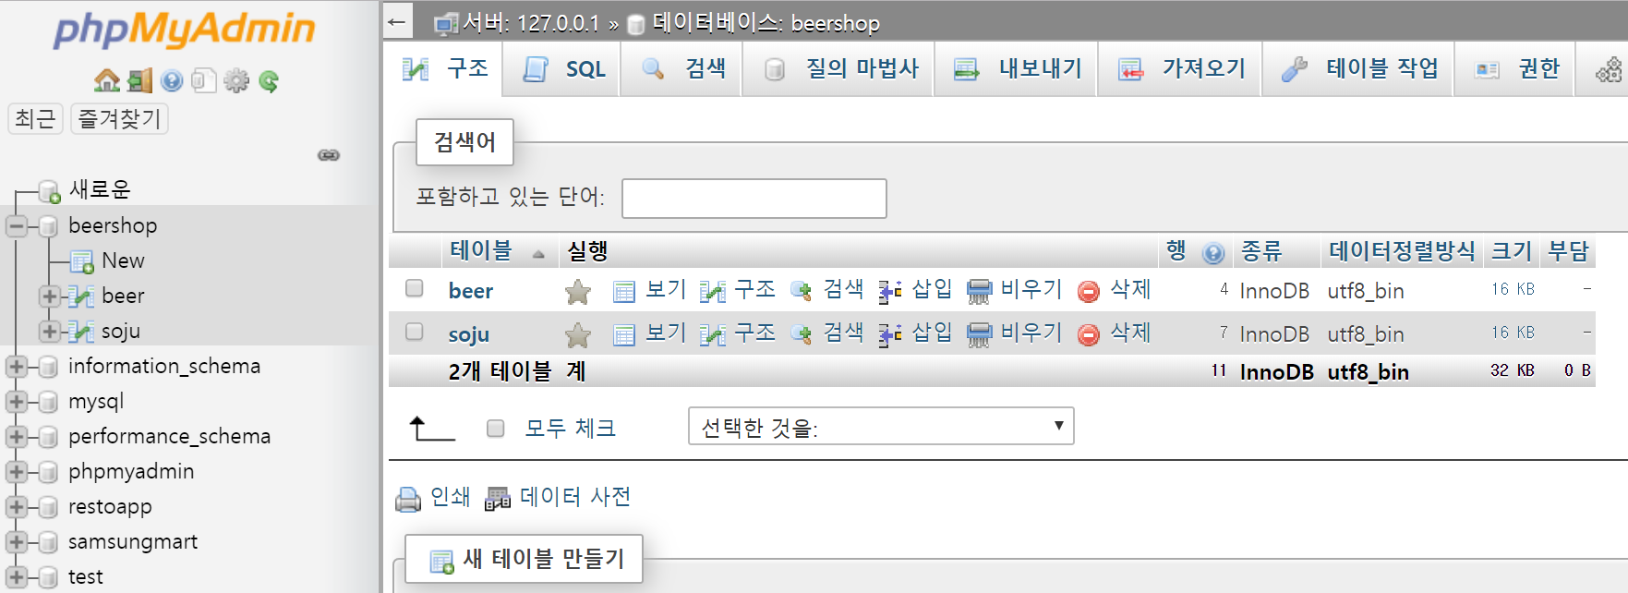
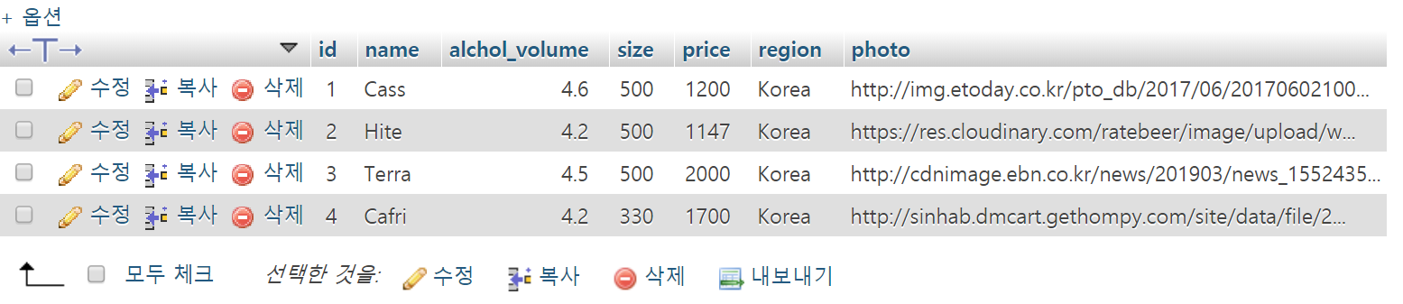
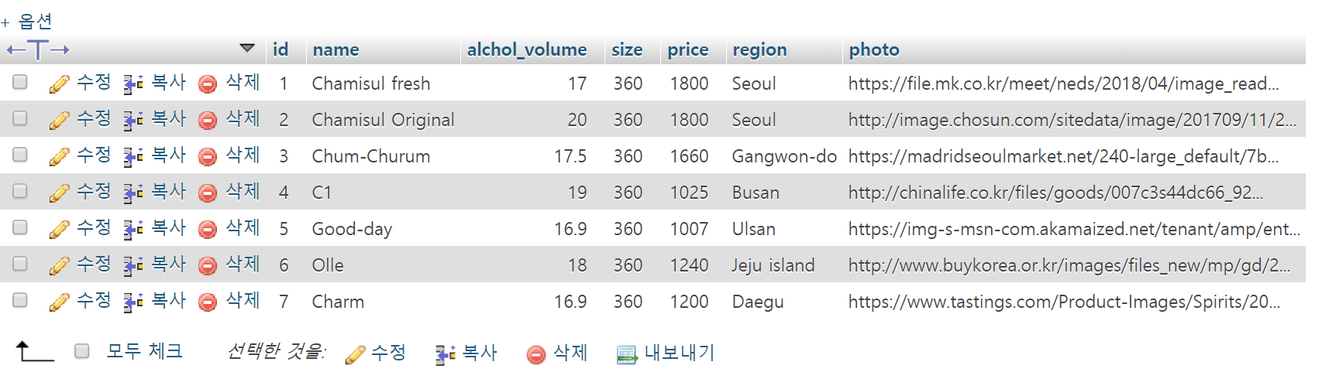
http://localhost/phpmyadmin

